Slide 1
Working Capital Management
Concepts of working capital;
Types of working capital:
Seasonal and permanent working capital
Factors affecting the size of working capital;
Significance of working capital management;
The cash conversion cycle;
Significance of inventory management;
Basic inventory costs;
The economic order quantity model;
Reorder point and safety stock;
Quantity discount;
Significance cash management,
Cash budget;
Purpose of receivables management;
Elements of credit policy

Slide 2
Concepts of Working Capital
Working Capital (to meet day to day operation)
Fixed Capital ( to finance fixed assets)
Working capital is also called circulating capital
CCC= ICP +RCP – PDP, where ICP+RCP is operating cycle.

Slide 3
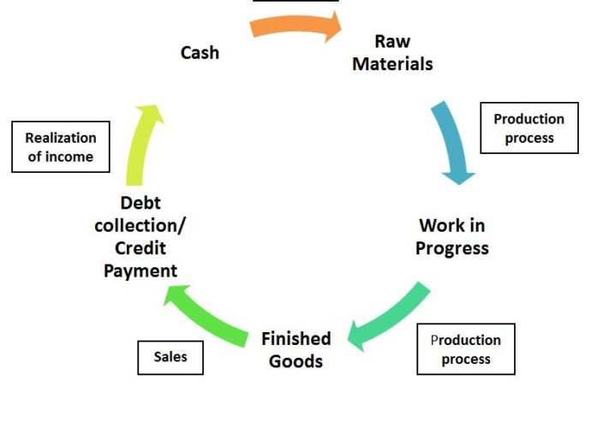
Concepts of Working Capital

Slide 4
Concept
Gross Concept:
Gross working capital
Total amount of current assets
Relevant for new company compare to existing because new company should identify level of inventory, cash and receivable.
Is higher GWC= high liquidity ??
NO, because we have to compare assets and liability to find liquidity.

Slide 5
Concept
ii. Net Concept
Net working capital ( i.e. CA- CL)
Part of investment in CA that is financed by long-term funds
Higher NWC = Higher Liquidity
Relevant to existing company as creditors wants high CA compare to CL.
iii. Zero Concept
WC= Inventory + Receivable – Payable results ZERO
Inventory and Receivable are components to generate sales

Slide 6
Concept
Net Working Capital is a part of short term fund (T or F)
False because if CL is insufficient to meet CA it is financed through Long term fund
NWC (i.e. CA-CL ) can be +ve or –ve
+ve NWC (CL will not finance CA)
-ve NWC (CL more that CA)

Slide 7
Example Problem
Example 1. If a firm has a cash balance of Rs 50,000, debtors of Rs. 70,000 and inventory of Rs 100,000, then calculate the gross working capital for the firm.
Example 2. If a firm has a cash balance of Rs. 100,000, debtors of Rs 150,000 and current liabilities of Rs 200,000, then calculate the net working capital of the firm.

Slide 8
Types of Working Capital
Permanent (Fixed) Working Capital
Minimal working capital to be maintained at all times
Remains same through out the year
Never will be zero
B. Variable (Seasonal) Working Capital
Fluctuating working capital over and above the permanent working capital
Increase or decrease with changes in sales / production

Slide 9
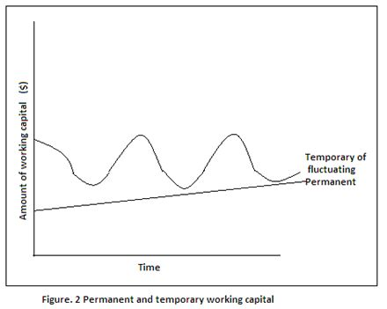
Types of Working Capital
Month | Total WC | Permanent WC | Temporary WC
Jan | 50,000 | 20,000 | 30,000
Feb | 60,000 | 20,000 | 40,000
Mar | 20,000 | 20,000 | 0
April | 90,000 | 20,000 | 70,000
May | 30,000 | 20,000 | 10,000

Slide 10
Working Capital Management
Management of current assets investment and their financing
Covers all decision of an organization involving cash flows in short-run with emphasis on management of investment in firm’s current assets and their financing
Maintain the CA and CL at a point, which represents the most satisfactory level of working capital.
Excessive CA= more use of long term fund which is costlier than short term funds
Inadequate CA= leads into technical bankruptcy as it becomes unable to satisfy its current obligation timely.
Optimum working capital insists on maintaining a trade-off between profitability and cost associated with CA investment and financing policy of firm

Slide 11
Importance/ Significance of Working Capital Management
Significant part of total assets
Maintaining a desired scale of operation
Maintaining regular cash flow
Survival of firm
Objectives of Working Capital Management:
Smooth working capital operating cycle
Lowest working capital
Minimize rate of interest or cost of capital
Optimal return on current assets investment

Slide 12
Factors Affecting Size of Working Capital
1. Volume of Sales
High Sales = High WC
Low Sales =Low WC
2. Seasonal and Cyclical Factors
Off season (low)
Peak season (High)
Boom(high)
Recession (low)
3. Firm’s credit policy
Liberal (high credit allowed so high WC)
Tight (low credit allowed so low WC)
4. Working Capital Policy
Aggressive (Low CA= Low WC)
Conservative ( High CA = High WC)
Moderate (in between)
5.Nature and size of Business
Manufacturing ( low WC ; long term assets)
Trading (High WC, Current assets is high)
Small Size ( Low WC ; low transaction)
Large Size ( High WC; high transaction)

Slide 13
Factors Affecting Size of Working Capital
6. Cost and Time involved in Manufacturing Process
High Input cost ( High WC; to buy raw materials)
Low Input Cost (Low WC)
Long Processing Time (High WC)
Short Processing Time (Low WC)
7. Cash Conversion Cycle
Long (High)
Short (Low)
8. Turnover of circulating capital
Fast task within operating cycle (Low WC)
Slow task within operating cycle (High WC)
9. Growth and Expansion Phase
High Growth ( High WC)
Low Growth (Low WC)
10. Predictability of Cashflow
Certainty ( Low WC)
Uncertainty (High WC)
11. Use of Technology
New Technology (Low WC)
Old Technology (High WC)
12. Access to money Market
Good Access ( Low WC)
Poor Access (High WC)

Slide 14
Cash Conversion Cycle
Cash conversion cycle refers to the length of time from the payment for purchase of raw materials to the collection of receivables. It indicates the length of time the firm has funds tied up in working capital
CCC=ICP + RCP –PDP
= Operating Cycle – PDP
Where,
ICP= Inventory Conversion Period
RCP= Receivable Conversion Period
PDP= Payable Deferral Period

Slide 15

Operating Cycle

Slide 16
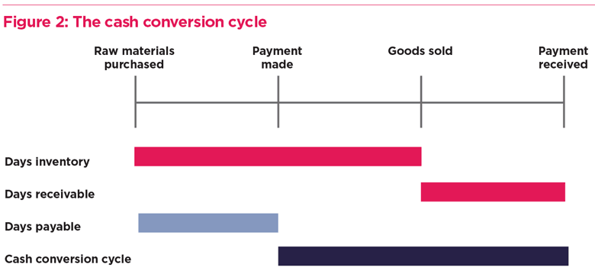
Fig: Cash Conversion Cycle

Slide 17
Cont.
The cycle and length of time gap differ from one organization to another organization even in the same industry as well as other industries.
Trading organizations need not to process raw materials and work in progress into finished products. Therefore the cycle for trading organization will be shorter than manufacturing organization.
Financial enterprises do not have this type of cycle. They are engaged in the business of borrowing and lending. They use different methods than that of manufacturing firms. In this section our focus will be on trading and manufacturing organization
Working Capital Financing requirement or Negotiated financing required=
Daily Production * Cost per unit * CCC
OR
Daily Investment in operating cycle (Working Capital )* CCC

Slide 18
Inventory Conversion Period (ICP)
Length of time required to convert raw materials into finished goods and to sell these goods
ICP = Days in a year / Inventory turnover ratio
OR
Inventory / Cost of goods sold per day
Inventory turnover ratio= Cost of goods sold/ Inventory
or
Sales / inventory

Slide 19
Example Problem
Example 3. Calculate the inventory conversion period in the following cases: Assume 360 days in a year:
A firms annual sales is Rs. 15,000,000 and its cost of goods sold is approximately 80% of sales. It keeps inventory equal to Rs. 1,000,000 at all the times
The sales and cost of goods sold of the firm are Rs. 10,000 and Rs 8,400 respectively. The beginning of year inventory is Rs 1,200 and the end of year inventory is Rs 1,000
A firm has a inventory turnover of 8 times

Slide 20
Receivable Conversion Period(RCP)
Length of time required to convert firm’s receivable into cash. It is also called as Days Sales Outstanding (DSO) or Average Collection Period (ACP)
RCP = Days in a year / Receivable turnover ratio
or
Receivable / Credit sales per day
Receivable turnover ratio= Credit Sales / Receivable

Slide 21
Example Problem
Example 4. Calculate the receivable collection period in the following cases: Assume 360 days in a year:
A firms annual sales is Rs. 15,000,000. The firm has receivables of Rs. 1,000,000.
The sales of the firm is Rs 10,000. The beginning of the year receivable is Rs. 1,200 and the end of year receivable is Rs. 1,000
A firm has a receivable turnover of 10 times
A firm’s annual sales is Rs 1 million, 80% of which are on credit and has a receivable of Rs. 70,000

Slide 22
Payable Deferral Period (PDP)
Length of time between the purchase of raw material and labor and payment of cash for them.
PDP = Days in a year / Payable turnover ratio
Or
= Payable / Cost of goods sold per day
Payable turnover ratio = Cost of goods sold / Payable
Or
= Credit Purchase / Payable
Note: Use average inventory, average receivable and average payable if the opening and closing information are provided by question.
Average = (Opening + Closing) / 2

Slide 23
Example Problem
Example 5. Calculate the Payable Deferred period in the following cases: Assume 360 days in a year:
A firms annual sales is Rs. 15,000,000 and its cost of goods sold is approximately 80% of sales. The firm has account payable of Rs. 900,000
The sales and cost of goods sold of the firm are Rs. 100,000 and Rs 84,000 respectively. The beginning of the year account payable is Rs 10,200 and the end of year account payable is Rs. 10,000
A firm account payable and credit purchase of Rs 20,000 and 450,000 respectively
Example 6.
Suppose it takes a firm an average of 30 days to convert materials and labor and to sell them, and it takes another 20 days to collect on receivables, while 30 days normally laps between receipt of materials and payments for materials and labor
What is firm’s cash conversion cycle ?
Suppose the firm’s daily expenses of Rs 1,500 and cash conversion cycle of 20 days, calculate external financing requirement

Slide 24
Basic Concept
Inventory is one of the major component of working capital.
An inventory is stock of goods which are held for future use
Types / Components of Inventory:
Raw Materials
Work in Progress
Finished Goods
Inventory Management deals with:
How many units should be ordered at a given period of time?
At what level of inventory should order be made?
What inventory items wants special attention?

Slide 25
Inventory Management
The main purpose of inventory management is to reduce the holding of inventory to the minimum necessary to conduct business operation.
It is an aspect of current assets management concerned with maintaining optimum investment in inventory and effective control of inventory.
Purpose of holding inventory:
Transaction motive
Precautionary motive
Speculative motive

Slide 26
Inventory Management
Benefits of Holding Inventory:
Avoiding losses of sales
Gaining quantity discounts
Reducing order cost
Achieving efficient production run
Determinants of Investment in Inventory:
Volume of sales ↑ ↑
Level of safety stock ↑ ↑
Carrying costs ↑ ↓
Economy in purchase ↑ ↑
Possibility of price rise ↑ ↑
Possibility of rise in demand ↑ ↑
Costs and availability of funds ↑ ↓
Length of production cycle ↑ ↑
Availability of materials (available on some season ) ↑ ↑
Nature and size of business ↑ ↑

Slide 27
Significance of Inventory Management
It helps to maintain adequate inventory for smooth production and sales operations.
It avoids stock-out problem that a firm otherwise would face in absence of the efficient inventory management
It suggests the proper inventory control system to be applied by a firm to avoid losses, damages and misuses.
It helps in maintaining a trade-off between carrying costs and ordering costs so as to minimize the total inventory cost.

Slide 28
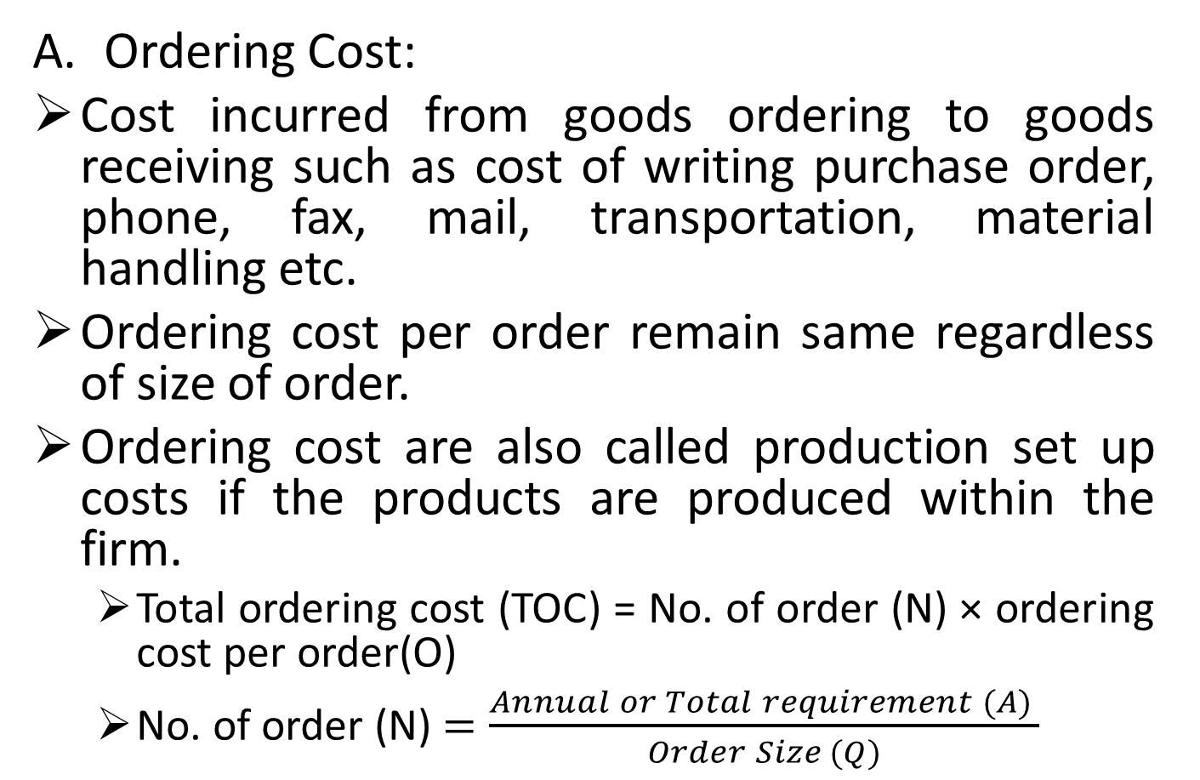
Basic Inventory Costs
Ordering Cost:
Cost incurred from goods ordering to goods receiving such as cost of writing purchase order, phone, fax, mail, transportation, material handling etc.
Ordering cost per order remain same regardless of size of order.
Ordering cost are also called production set up costs if the products are produced within the firm.
Total ordering cost (TOC) = No. of order (N) × ordering cost per order(O)
No. of order (N) $=\frac{Annual or Total requirement (A) }{Order Size (Q)}$

Slide 29
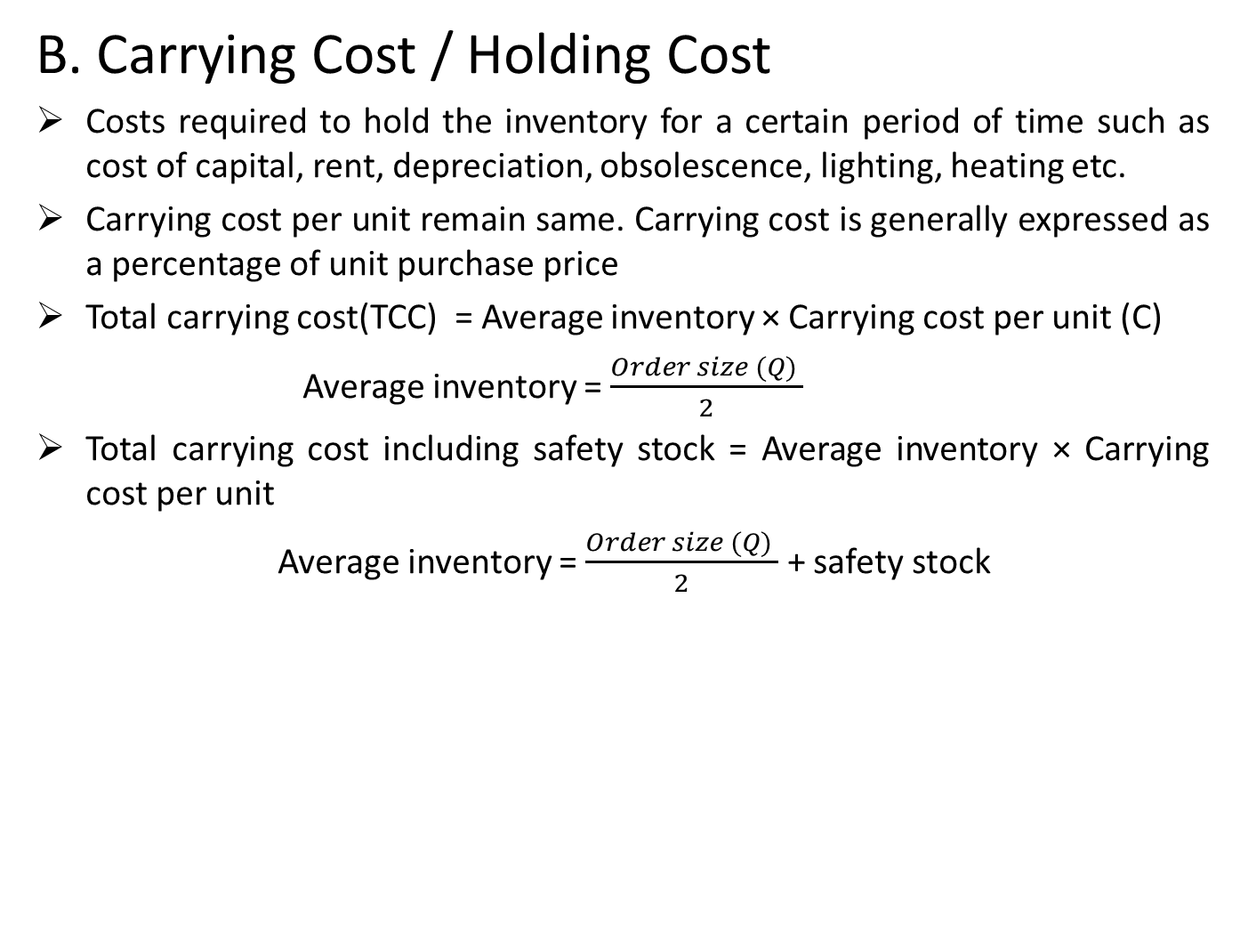
Basic Inventory Costs
B. Carrying Cost / Holding Cost
Costs required to hold the inventory for a certain period of time such as cost of capital, rent, depreciation, obsolescence, lighting, heating etc.
Carrying cost per unit remain same. Carrying cost is generally expressed as a percentage of unit purchase price
Total carrying cost(TCC) = Average inventory × Carrying cost per unit (C)
Average inventory = $\frac{Order size (Q) }{2}$
Total carrying cost including safety stock = Average inventory × Carrying cost per unit
Average inventory = $\frac{Order size (Q) }{2}$ + safety stock

Slide 30
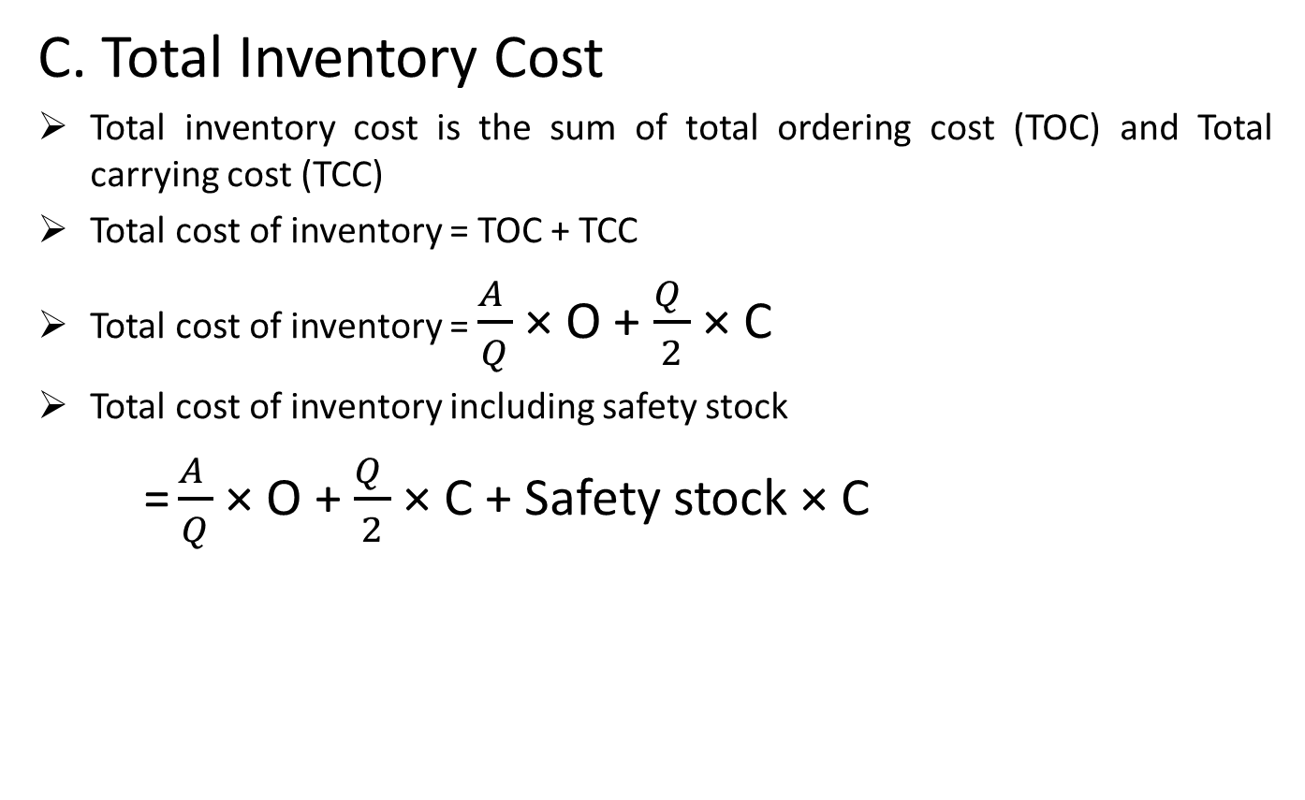
Basic Inventory Cost
C. Total Inventory Cost
Total inventory cost is the sum of total ordering cost (TOC) and Total carrying cost (TCC)
Total cost of inventory = TOC + TCC
Total cost of inventory = $\frac{A }{Q}$ × O + $\frac{Q }{2}$ × C
Total cost of inventory including safety stock
= $\frac{A }{Q}$ × O + $\frac{Q }{2}$ × C + Safety stock × C

Slide 31
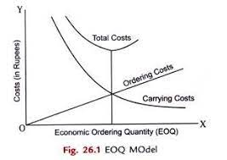
Economic Order Quantity Model
EOQ is that optimum level of order size at which total ordering cost and total carrying cost are equal and total cost of inventory is minimum.
Methods of calculating EOQ:
Graphical Method

Slide 32
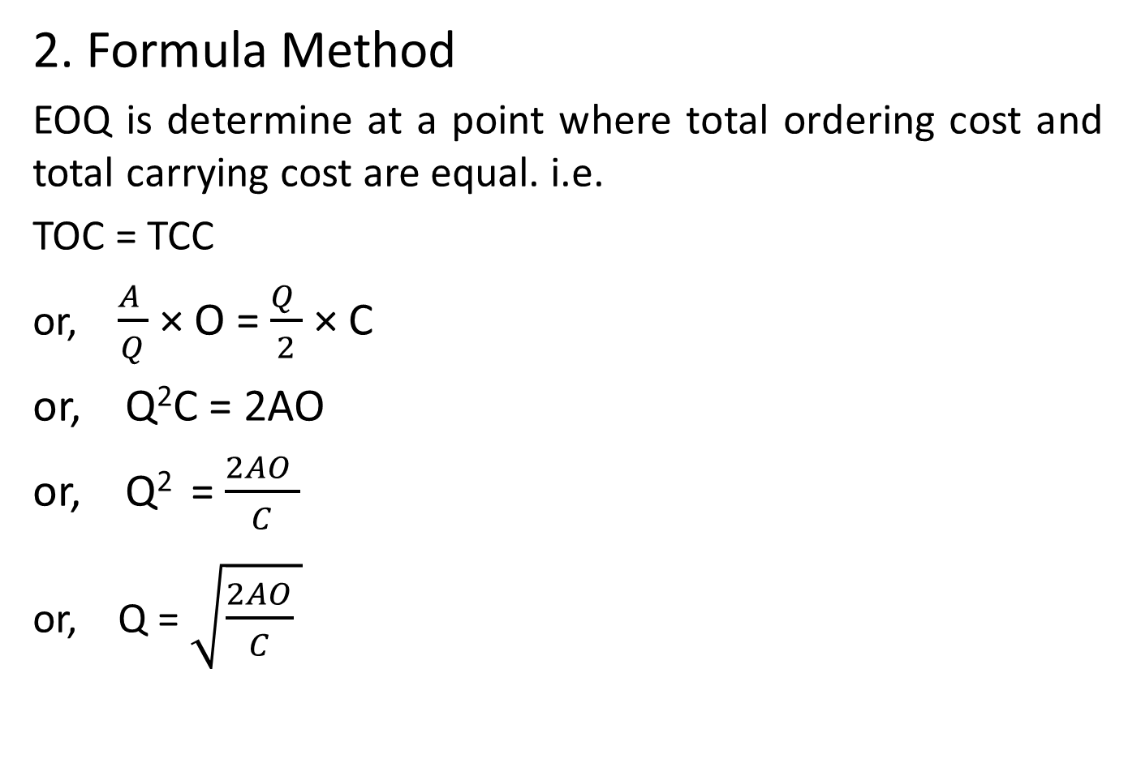
Economic Order Quantity Model
2. Formula Method
EOQ is determine at a point where total ordering cost and total carrying cost are equal. i.e.
TOC = TCC
or, $\frac{A }{Q}$ × O = $\frac{Q }{2}$ × C
or, Q²C = 2AO
or, Q² = $\frac{2AO }{C}$
or, Q = $\sqrt[ ]{{\frac{2AO}{C}}^{ }}$

Slide 33
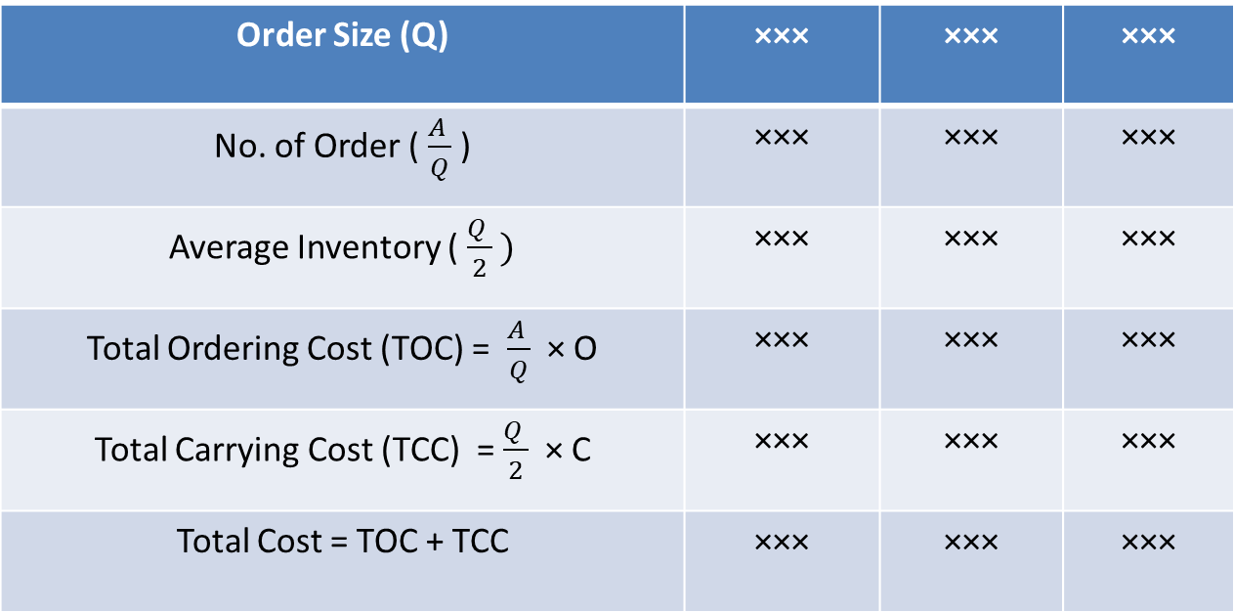
Economic Order Quantity
3. Tabulation or Trial and error method
Order Size (Q) | ××× | ××× | ×××
No. of Order ($\frac{A }{Q}$ ) | ××× | ××× | ×××
Average Inventory ($\frac{Q }{2} )$ | ××× | ××× | ×××
Total Ordering Cost (TOC) = $\frac{A }{Q}$ × O | ××× | ××× | ×××
Total Carrying Cost (TCC) = $\frac{Q }{2}$ × C | ××× | ××× | ×××
Total Cost = TOC + TCC | ××× | ××× | ×××

Slide 34
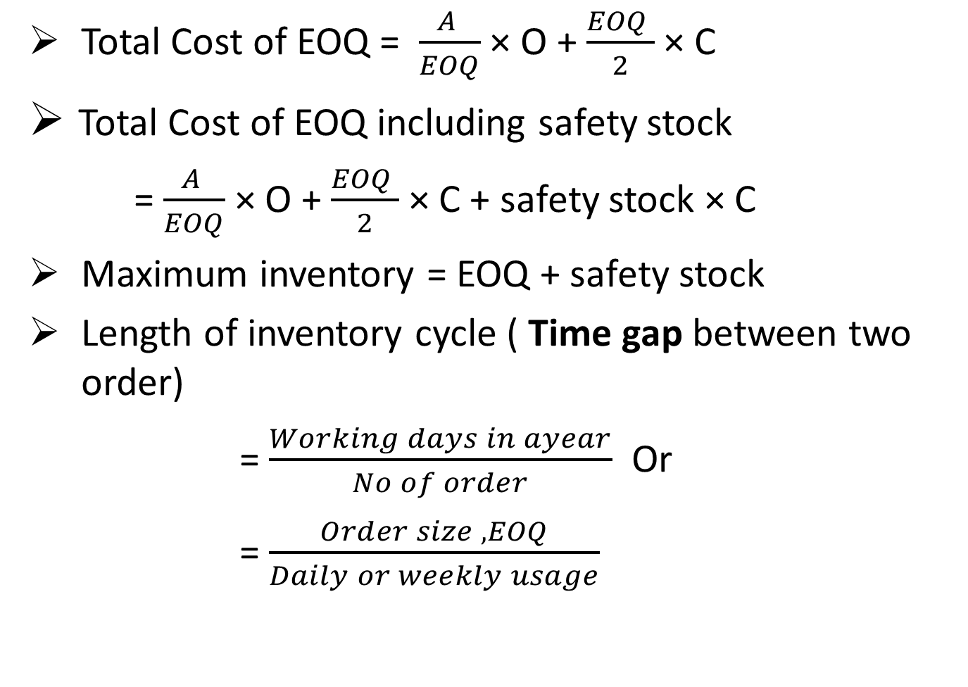
Other Formulae
Total Cost of EOQ = $\frac{A }{EOQ}$ × O + $\frac{EOQ }{2}$ × C
Total Cost of EOQ including safety stock
= $\frac{A }{EOQ}$ × O + $\frac{EOQ }{2}$ × C + safety stock × C
Maximum inventory = EOQ + safety stock
Length of inventory cycle ( Time gap between two order)
= $\frac{Working days in ayear}{No of order}$ Or
= $\frac{Order size , EOQ}{Daily or weekly usage}$

Slide 35
Example Problem
Example 7: Consider the following information:
Annual Requirement = 1,125,000 units
Order Cost = Rs 500 per order
Carrying Cost = 25%
Purchase Price = Rs 5
Calculate EOQ and total cost by using :
Formula Method
Graphic Method
Table Method

Slide 36
Reorder Point
Assumption like sales are forecasted with certainty, level of usage are constant overtime and inventory could be replaced immediately when required are not possible in real life. So it is necessary to determine when next reorder should be placed.
Time taken between placing an order and receiving the order is known as lead time.
Reorder point (ROP) or reorder level refers to the level of inventory at which a reorder should be placed so as to receive the inventory at time before the stock is finished.
In case of certainty,
ROP = Average lead time × Average usage

Slide 37
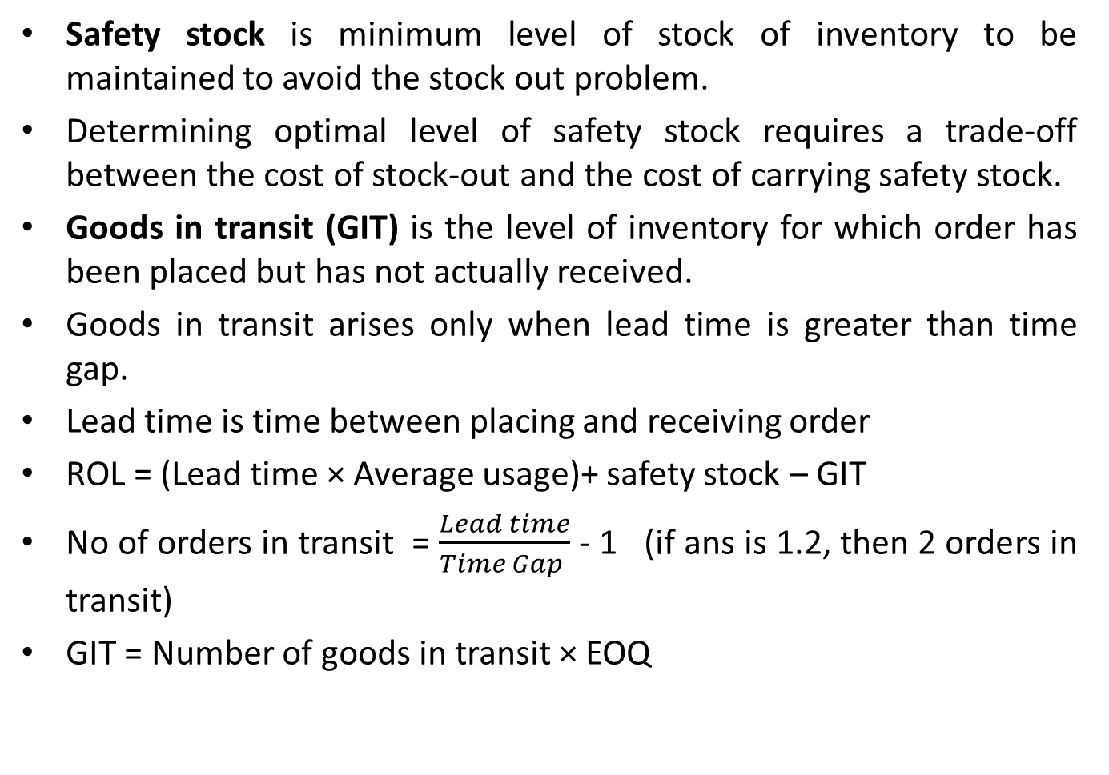
Reorder Point and Safety Stock
Safety stock is minimum level of stock of inventory to be maintained to avoid the stock out problem.
Determining optimal level of safety stock requires a trade-off between the cost of stock-out and the cost of carrying safety stock.
Goods in transit (GIT) is the level of inventory for which order has been placed but has not actually received.
Goods in transit arises only when lead time is greater than time gap.
Lead time is time between placing and receiving order
ROL = (Lead time × Average usage)+ safety stock – GIT
No of orders in transit = $\frac{Lead time}{Time Gap }$ - 1 (if ans is 1.2, then 2 orders in transit)
GIT = Number of goods in transit × EOQ

Slide 38
Example Problem
Example 8:
The following information for inventory purchase and storage cost has been for Delta Trade Center:
Order must be placed in multiple of 100 units
Requirements for the year are 1,000,000 units assuming 50 weeks in a year
The purchase price per unit is Rs. 200
The carrying cost is 10 percent of inventory value
The cost per order placed is Rs. 1,000
Desired safety stock is 5,000 units (on hand initially)
One week is required for delivery
What is the most economical ordering quantity ?
What is the optimal number of orders to be placed ?
At what inventory level should a reorder be made ?

Slide 39
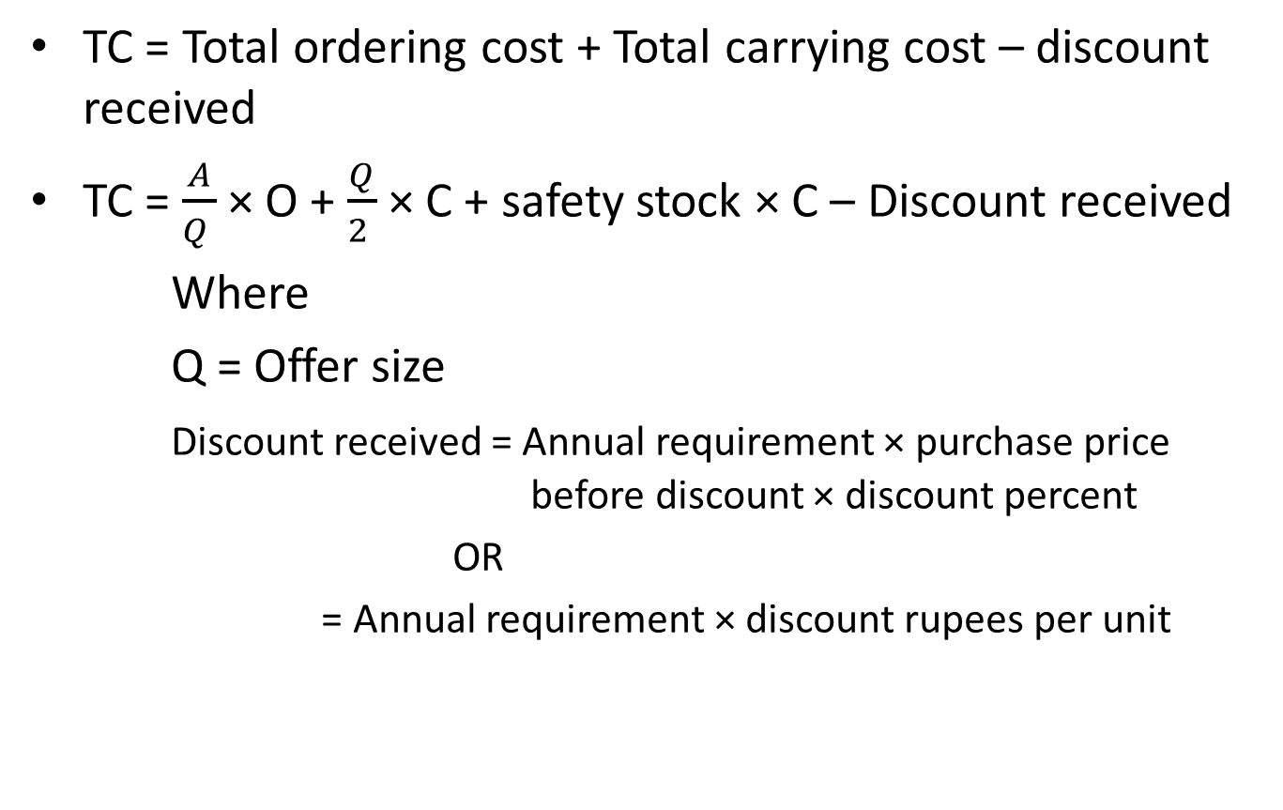
Quantity Discount
TC = Total ordering cost + Total carrying cost – discount received
TC = $\frac{A}{Q }$ × O + $\frac{Q}{2 }$ × C + safety stock × C – Discount received
Where
Q = Offer size
Discount received = Annual requirement × purchase price before discount × discount percent
OR
= Annual requirement × discount rupees per unit

Slide 40
Quantity Discount with Price Break
If order size is increased enough, the price is discounted.
Discount price is progressive depending upon the order size which implies that larger discount on price is offered by supplier for larger order size. This is called price break.
We apply following steps to determine the most economical EOQ
Step 1: Calculate EOQ for each price level starting from lowest price until a feasible EOQ is found
If the first feasible EOQ lies at the lowest price level, this quantity will be the best order quantity otherwise we need to calculate total cost at the first feasible EOQ and other larger price break quantity at each lower price level. The quantity with lowest cost is optimum.

Slide 41
Example Problem
Example 9:
Mr. A buys pens from the Oxford Company and sells in the market. He anticipates annual sales of 40,000 pens for his market area. The Oxford Company charges prices as mentioned in the table for different order sizes of pens in receive from its customers.
The purchase ordering cost is Rs. 10 per order and the storage cost is 20 percent of the price paid for each pen, what is the optimum number of units that Mr. A should order ?
Order Size | Price Per Pen
0-999 units | Rs 20
1000-1999 units | 17.5
2000 or more units | 15.50

Slide 42
Overview of cash management
Cash is one of the major component of working capital. It includes coins, currencies , cheques , bank balance and near cash assets such as marketable securities .
Cash management is also called as management of money position because cash includes not only the cash currently in hand but also the readily convertible securities and other near cash items.
Cash is also called as non earning assets because cash itself do not generate any return but it is needed to pay for material and labor and to buy fixed assets.

Slide 43
Overview of cash management
Cash management deals with;
Management of cash inflow and cash outflow
Management of cash balance held by the firm at a point of time
The goal of cash management is to reduce the holdings of cash to the minimum necessary to conduct business operation. It should ensure adequate cash i.e. neither more nor less.
Motives of holding cash/ Reasons for holding cash
Transaction motive:
Cash is needed to carryout day to day operations such as payment of salary and wages , payment for purchase of raw material, payment of tax and dividend and other petty expenses etc

Slide 44
Overview of cash management
What should be the level of cash to satisfy transaction motive?
The firm`s level of operation determines the level of cash to satisfy transaction motive
Transaction cash balance vary less than in proportion changes in volume of sales : Baumol and Tobin.
Transaction cash balance vary more than in proportion changes in volume of sales : Friedman
The study held on Nepalese enterprises also supported the findings of Baumol and Tobin

Slide 45
Overview of cash management
ii. Precautionary motive:
Cash hold for the payment of unpredictable or unanticipated events such as strikes lock up ,increase in cost of raw materials , fall in demand , machinery breakdown etc.
How much cash held against these emergencies ? It depends on the degree of predictability associated with cash flow.
The precautionary needs for holding cash usually is satisfied by holding near cash items such as investment in marketable securities.
iii. Speculative motive:
Cash hold to take advantages of expected change in price. When interest rate is expected to rise, the price of the securities will decrease. The firm should hold cash until the rise interest rate ceases. When interest rate is expected too fall , cash may be invested in securities.
Purchase inventory at a low price with a view to sell in the future at high price.

Slide 46
Overview of cash management
iv. Compensating balance requirement :
Cash balances are kept in bank to compensate for banking service the firm receives.
Advantages of Adequate cash:
To take trade discount
To take cash discount
To maintain liquidity
To meet emergencies
To facilitate smooth operation etc

Slide 47
Significance of Cash Management
Management of Cash flows
Meeting the Obligatory Cash flows
Planning Capital Expenditure Projects
Favorable External Financing
Advantage of Business Opportunities
Investment of Surplus Cash

Slide 48
Cash Budget
Particulars | January | February | March
Opening Cash Balance | ××× | ××× | ×××
Add: Cash Receipt
Cash sales | ××× | ××× | ×××
Collection from debtors
Same month’s collection | ××× | ××× | ×××
Last month’s collection | ××× | ××× | ×××
Before last month’s collection | ××× | ××× | ×××
Issue of shares and debentures | ××× | ××× | ×××
Sale of assets | ××× | ××× | ×××
Interest, dividend, commission receipts | ××× | ××× | ×××
Other cash receipts | ××× | ××× | ×××
Total Cash Receipts ‘A’ | ××× | ××× | ×××
Cash Payments (Disbursement) | ××× | ××× | ×××
Cash Purchase | ××× | ××× | ×××
Payment for credit purchase | ××× | ××× | ×××
Payment for wages, salaries and commission | ××× | ××× | ×××
Payment for rent | ××× | ××× | ×××

Slide 49
Cont. Cash Budget
Particulars | January | February | March
Payment for dividend and interest | ××× | ××× | ×××
Purchase of new assets | ××× | ××× | ×××
Payment for tax | ××× | ××× | ×××
Other cash payment | ××× | ××× | ×××
Total Cash Payment | ××× | ××× | ×××
Add: Minimum cash balance | ××× | ××× | ×××
Total Cash Needed ‘ B’ | ××× | ××× | ×××
Surplus or (Deficit) (A-B) | ××× | ××× | ×××
Add: Borrowing, if deficit | ××× | ××× | ×××
Less: Repayment of loan, if saving | ××× | ××× | ×××
Less: Repayment of interest | ××× | ××× | ×××
Balance | ××× | ××× | ×××
Add: Minimum cash balance | ××× | ××× | ×××
Ending cash balance | ××× | ××× | ×××

Slide 50
Example Problem 10
A company has furnished the following estimates of income and expenditure for the coming six months from July to December.
The following additional information are also available:
Typically, the company collects 20% of its sales in the month of sales, 70% in the subsequent month, and 10% in the second month after the sale
Purchase of raw materials is made in the month prior to the sales and amount to 50% of sales in subsequent month. Payments for this purchase occur in the month after the purchase.
The time lag for manufacturing expenses is 15 days and for other expenses is one month.
Months | Sales | Wages | Mfg exp | Office exp | Selling exp
July | 45,000 | 10,000 | 6,000 | 4,000 | 3,000
August | 60,000 | 15,000 | 6,000 | 5,000 | 4,000
September | 50,000 | 16,000 | 5,000 | 6,000 | 3,000
October | 65,000 | 16,500 | 7,000 | 7,500 | 4,000
November | 85,000 | 16,500 | 8,000 | 7,500 | 6,000
December | 90,000 | 16,500 | 8,000 | 8,000 | 6,000

Slide 51
Question Cont…
A machine costing Rs 1,00,000 is due for delivery in September. Half of its cost will be payable immediately and remaining half will be paid in two installments in the next two months
A sum of Rs 5,000 will be paid as interest on borrowed capital on September and Rs 10,000 as dividend on equity capital in October.
A sum of Rs 45,000 will be received as proceeds of sale of old machine in December, out of this Rs 3,000 will be paid as commission and balance will be received for this sale
Six month interest of Rs 500 on bank fixed deposit will accrued to the company in September.
Tax payment of Rs 10,000 will become due on November. The cash balance on 1st September was 80,000 with the firm
Sales for the coming January Rs 70,000
Rs 70,000 being the amount of second call money may be received in November.
The company holds minimum cash balance of Rs 20,000 and excess of Rs 30,000 if any deposited into bank. The company has negotiated with its bank for temporary borrowing in the multiple of Rs 5,000 with interest of 12% p.a. on the loan. The loan is to be repaid in the multiple of Rs 1,000. and interest is paid at the time of payment of loan. Assume that the loan is taken on the first date of the month and repaid on the last date.
On the basis of above data prepare a cash budget from September to December.

Slide 52
Solution
Particular | September | October | November | December
Opening cash Balance | 80,000 | 27,500 | 23,000 | 20,980
ADD: cash receipt (cash sales if given)
Collection from debtors
same month 20% | 10,000 | 13,000 | 17,000 | 18,000
month after sell 70% | 42,000 | 35,000 | 45,500 | 59,500
second month after sell 10% | 4,500 | 6,000 | 5,000 | 6,500
Sale of old machine |  |  |  | 45,000
Interest on deposit | 500
Second call money |  |  | 70,000
Total Cash Available ‘A’ | 137,000 | 81500 | 160,500 | 149,980
Less: Cash Disbursement
Payment for purchase | 25,000 | 32,500 | 42,500 | 45,000
Payment for Manufacturing
same month 50% | 2,500 | 3,500 | 4,000 | 4,000
next month 50% | 3,000 | 2,500 | 3,500 | 4,000
Wages | 15,000 | 16,000 | 16,500 | 16,500

Slide 53
Particular | September | October | November | December
Office expenses | 5,000 | 6,000 | 7,500 | 7,500
Selling expenses | 4,000 | 3,000 | 4,000 | 6,000
Payment for machinery | 50,000 | 25,000 | 25,000 | -
Interest on loan | 5,000 | - | - | -
Dividend | - | 10,000 | - | -
Commission | - | - | - | 3,000
Tax | - | - | 10,000 | -
Total cash Payment | 109,500 | 98,500 | 113,000 | 86,000
Add: Minimum cash balance | 20,000 | 20,000 | 20,000 | 20,000
Total cash needed ‘B’ | 129,500 | 118,500 | 133,000 | 106,000
Surplus / Deficit (A-B) | 7,500 | (37000) | 27,500 | 43,980
Add: Borrowing i.e. Loan (if deficit) | - | 40,000 | - | -
Less: Repayment of loan (if surplus) | - | - | 26,000 | 14,000
Repayment of interest | - | - | 520 | 420
Balance | 7,500 | 3,000 | 980 | 29,560
ADD: Minimum cash balance | 20,000 | 20,000 | 20,000 | 20,000
Closing cash balance | 27,500 | 23,000 | 20,980 | 49,560
Cash in hand | 27,500 | 23,000 | 20,980 | 30,000
Cash at bank | 0 | 0 | 0 | 19560

Slide 54
Rough Sheet
Purchase = 50% of next month sales October= 50% of 85000 = 42500
August= 50% of 50,000 = 25000 November = 50% of 90000 = 45000
September = 50% of 65000 = 32500 December =50% of 70000 = 35000
Payment for manufacturing expenses = 15 days
Next month = 15/30 = 50% If 10 days , then next month = 10/30 =1/3
Same month = (30-15)/30 = 50% same month = 20/30 = 2/3
Let repayment of principal be x
x + x × 12% × $\frac{2}{12}$ = 27500 x = 26960.8
Repayment of principal = 26000
Interest = 26000 × 12% × $\frac{2}{12}$ = 520
Interest in December = 14000 × 12% × $\frac{3}{12}$ = 420
Sep 50000 | Oct 65000 | Nov 85000 | Dec 90000 | Aug 60000 | July 45000
S: 20%, 10K | O: 20%,13K | N: 17000 | D: 18000 | A: 12000 ,20% | J: 20%
O: 70%, 35K | N: 70%, 45.5K | D: 59500 | J: A/R (?) | S: 42000 ,70% | A: 70%
N: 10%, 5K | D: 10%, 6.5K | J:8500 (A/R) | F:A/R (?) | O: 6000, 10% | S: 10%,4500

Slide 55
Concept of Receivable
Account Receivable / Debtors: It is one of the important components of current assets. When a firm sells goods on credit rather than requiring immediate cash payment such kind of credit sales generates account receivable.
Why does the firm sell goods on credit ?
To maintain and promote sales
To expand market
To attract new customers
To compete in the competitive world
Benefits: Costs:
Increase in sales Cost of financing
Incremental profit Collection and administration cost
Economies of scale Bad debts
Indirect benefit: Market leadership and Cash discount
long term customer loyalty

Slide 56
Purpose of Receivable Management
The main purpose of a firm’s receivable management is to determine effective credit policy that increases the efficiency of the firm’s credit and collection department and contributes to the maximization of value of the firm.
The specific purpose of receivable management are as follows:
To evaluate the creditworthiness of customer before granting credit
To minimize the cost of investment in receivable
To minimize the possible bad debt losses
To formulate credit terms
To minimize the cost of running credit and collection department
To maintain a trade off between costs and benefits associated with credit management.

Slide 57
Credit Policy
Credit Policy: A firm’s credit policy provides guidelines for determining whether to extend credit to a customer and how much to credit extend.
Elements of credit policy:
Credit Standard: It refers to the criteria for determining which customer will be granted credit and how much. OR
Credit Standards are the minimum criteria for the extension of a credit to a customer
Factors to be considered while setting credit standard : 5C’s
Character: Borrower’s willingness to pay. From where information can be obtained?
Sources: Credit reports, past experience, relation with other suppliers.

Slide 58
Credit Standard
Capacity: Borrower’s ability to pay i.e. cash income
Capital: Borrowing capacity (debt ratio, debt equity ratio, current ratio, quick ratio)
Collateral: Assets pledged by the firm
Condition: General economic condition
Impacting of relaxing credit standard on net income:
Particulars | Direction of change | Effect on NI
Sales | Increase | Positive
Investment in A/R | Increase | Negative
Bad debt | Increase | Negative

Slide 59
Credit Policy
B. Credit Term : It refers to the condition under which a firm sells its goods and services on credit.
Credit term covers three components: 2/10 net30
Cash discount % : Discount offered to the credit customer for early payment of their dues.
Impact of increasing cash discount on net income:
Particulars | Direction of change | Effect on Net Income
Sales | Increase | Positive
Cash discount | Increase | Negative
Investment in A/R | Decrease | Positive
Bad debt | Decrease | Positive

Slide 60
Credit Term
ii. Cash discount period: Time period during which discount can be obtained by making payment.
Impact of relaxing discount period on net income:
Particulars | Direction of Change | Effect on Net Income
Sales | Increase | Positive
Investment in A/R | Decrease (due to non discount customer now paying earlier) Increase (due to discount taking customer still getting cash discount but paying later) | Positive Negative
Bad debt | Decrease | Positive

Slide 61
Credit Term
iii. Credit Period: Final due date of accounts receivable.
Impact of increasing credit period on net income:
Particular | Direction of change | Effect on Net Income
Sales | Increase | Positive
Investment in A/R | Increase | Negative
Bad debt | Increase | Negative

Slide 62
Terms of sale
Net 30
The bill must be paid within 30 days from the invoice date
2/10 net 30
2 percent discount can be obtained if the payment is made within 10 days; otherwise, whole payment should be made within 30 days.
Net 10 EOM
All goods shipped before the end of month must be paid10th of the following month. In other words, credit period begins from the end of month
2/10 net 30 EOM
Time of discount and credit period begins from the end of month
2/10 net 30 MOM
Discount period and credit period begins from the middle of the month if the invoice date lies between 1 to 15 and begins from the end of the month if the invoice date lies between 15th to last date of the month.

Slide 63
Credit Terms and Payment Date
Invoice Date | Credit Term | Payment dates
 |  | Discount Taken | Discount Forgone
May 10 | 2 / 10 net 30 | May 20 | June 10
May 10 | 2/ 10 net 30 EOM | June 10 | June 30
May 10 | 2/10 net 30 MOM | May 25 | June 15
May 20 | 2/10 net 30 MOM | June 10 | June 30
May 10 | Net 30 | - | June 10
May 10 | Net 10 EOM | - | June 10

Slide 64
Credit Policy
C. Collection Policies: Procedures followed by the firm when the customers fail to pay their due within period.
Steps:
Remind letter
Telephone calls
Personal visit
Legal action
D. Monitoring Account Receivable Position:
Periodic evaluation of receivables and customers payment pattern to ensure the credit policy is being administered correctly.
Tools used by the firm to monitor the receivable position of the firm:
Days sales outstanding / Average collection period
Aging schedule

Slide 65
Aging Schedule
It is a tabular classification of receivables showing the length of time accounts have been outstanding. It is prepared by amount of time account and percentage. The analysis of aging schedule is meaningless in the absence of credit term.
Days sales outstanding provide average collection days based on aggregate data but it does not provide the specific information about the age of account receivable in detail. The aging schedule eliminates this drawback because it gives a detail breakdown of account receivable on the basis of length of time for collection.
Example:
Current A/R
Outstanding with
Term of net 30
If the credit term are net 30, 50% of receivable are overdue. The firm is lagging behind the collection of receivables.
Age of accounts | Value of account | % of total
0-30 | 300 | 50
31-60 | 150 | 25
61-90 | 100 | 17
91-120 | 20 | 3
More than 120 | 30 | 5

